Slide 1
Chapter 4.
The Network Layer

Slide 2
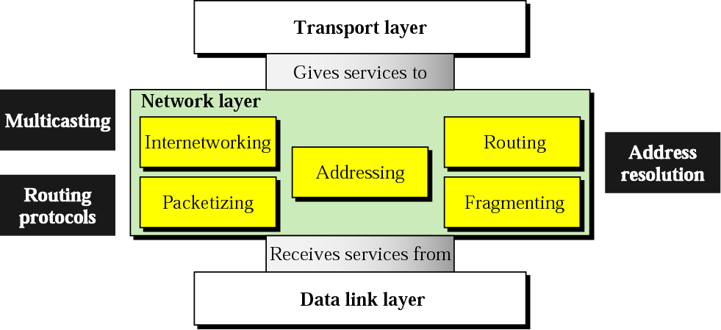
the network layer is responsible for carrying a packet from one computer to another; it is responsible for host-to-host delivery
position of the network layer

Slide 3
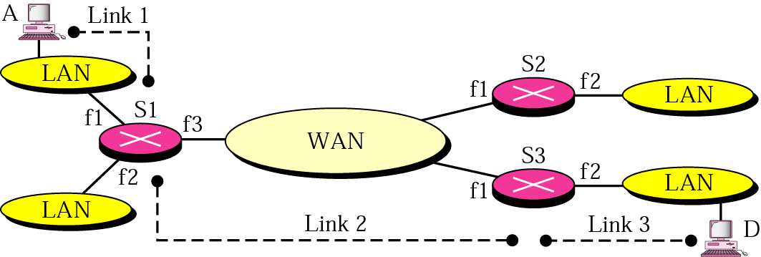
4.1 Internetworking
internetworking refers to the logical gluing of heterogeneous physical networks together to look like a single network to the upper transport and application layers
the above internetwork is made up of 5 networks: 4 LANs and 1 WAN
S_{i}: switch or router; f_{i}: interface
data sent from A to D passes through 3 links
nomenclature:
the source and the destinations are usually referred to as hosts
a host or a router is referred to as a hop

Slide 4
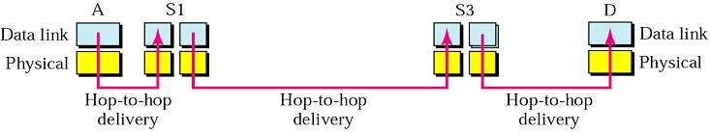
in each link, 2 physical and data link layers are involved
problem:
when data arrives at S₁, how does it know that it should be sent to S₃?
the physical and data link layers do not help S₁
the frame does not carry any routing information, it contains the MAC addresses of A as the source and that of S₁ as the destination (for a LAN or a WAN, delivery means carrying the frame through one link, not beyond)
the network layer is responsible for host-to-host delivery and for routing the packets through the routers or switches

Slide 5
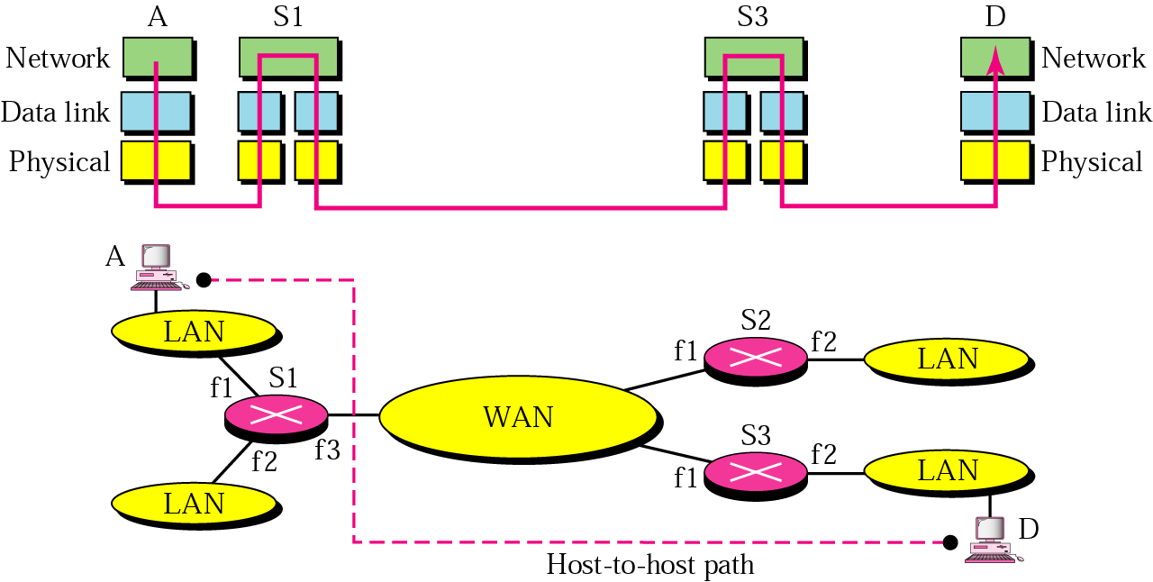
network layer at source
receives data from the transport layer
adds the universal addresses of A and D
makes sure the packet is of correct size for passage through the next link, fragment it if necessary
network layer at router or switch
responsible for routing the packet using a routing table
the packet may go through another fragmentation if need be
network layer at destination
address verification; error detection; reassembling the fragments
delivering to the transport layer

Slide 6
4.2 Addressing
to uniquely and universally identify each device on the Internet to allow global communication between all devices
analogous to the telephone system; the Department of Computer Science: 251 011 1222922, wherever you are on the globe
each address belongs to a single host, but a single host can have multiple addresses (if it has multiple connections to the Internet)
the identifier used in the network layer of the Internet model is called the Internet address or IP address
it is a 32-bit binary address (in IPv4)

Slide 7
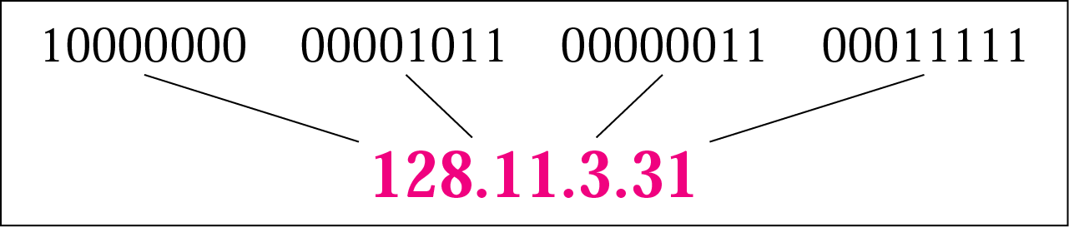
two common notations: binary notation and dotted-decimal notation
binary notation: one or more spaces inserted between each octet (8 bits)
10000000 00001011 00000011 00011111
dotted-decimal notation: to make it more compact and easier to read (for humans)
we will study IP addresses later

Slide 8
4.3 Routing, Routing Protocols and Multicasting
making a decision and choosing one route whenever there are multiple routes
based on some criteria; how do you choose a route when you drive? may be the condition of your car and the road, the shortest one, the one that is not congested, the one with less traffic lights, avoid forbidden paths (American military packets may not pass through Russia), ...
it is the job of the network layer routing protocol; a combination of rules and procedures that lets routers in the internet inform one another of changes (to share whatever they know about the internet or their neighborhood); e.g. a failure of a network can be communicated
at the heart of such protocol is the routing algorithm that determines the path for a packet

Slide 9
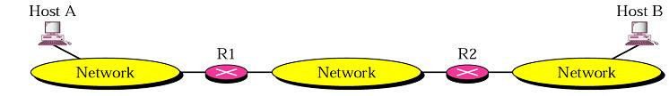

routing requires a host or a router to have a routing table which is constructed by the routing algorithm
given big internetworks such as the Internet, the number of entries in the routing table becomes large and table look ups become inefficient; methods for reducing its size are required

Slide 10

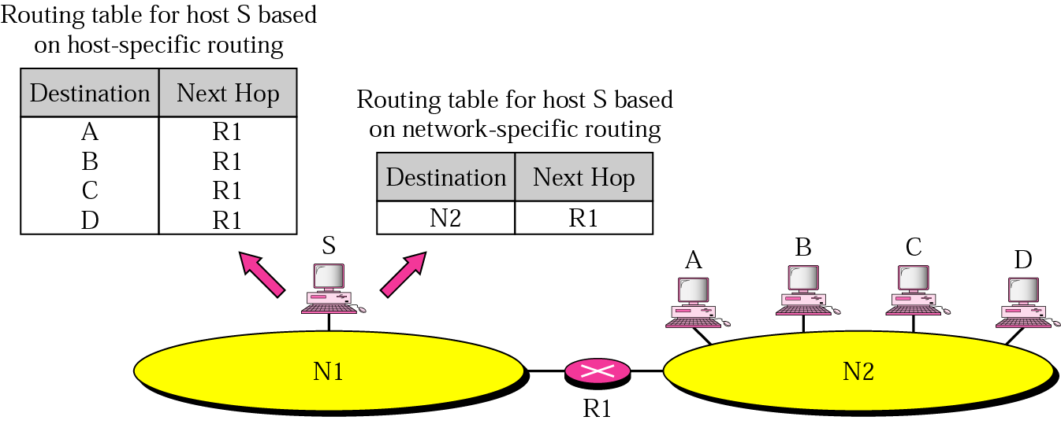
next-hop routing
the routing table holds only the information that leads to the next hop
network-specific routing
instead of having an entry for every host connected to the same physical network, there is only one entry to define the address of the network itself

Slide 11
two kinds of routing algorithms (routing tables): nonadaptive (static) and adaptive (dynamic)
nonadaptive (static)
routing decisions are not based on measurements or estimates of the current topology or traffic
the choice of a route is computed in advance, off-line, and downloaded to the routers when the network is booted or
an administrator enters the route for each destination into the table
not automatically updated when there is a change
may be used in a small internet, but not for big internet like the Internet

Slide 12
adaptive (dynamic)
routing decisions are made periodically (every δ sec) to reflect changes in the topology, traffic, a shutdown of a router, a break in the link, a better route has been created, ...

Slide 13
interior and exterior routing (protocols)
since an internet can be large, one routing protocol cannot handle the task of updating the routing tables of all routers
hence, an internet is divided into autonomous systems
an autonomous system (AS) is a group of networks and routers under the authority of a single administration
routing inside an autonomous system is referred to as interior routing; each AS can choose its own routing protocol
routing between autonomous systems is referred to as exterior routing; one protocol is usually chosen to handle routing between autonomous systems; usually used for routing in the Internet

Slide 14
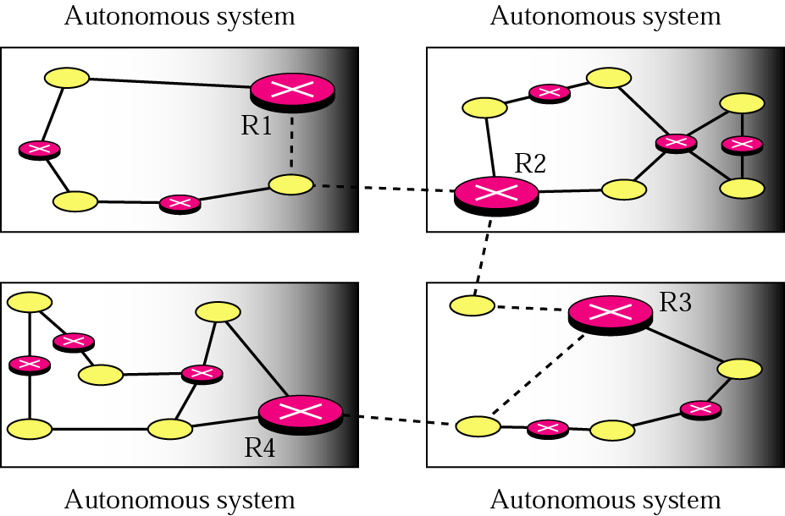
R1, R2, R3, and R4 use both interior and exterior routing protocols
the rest use only interior routing protocols
solid lines - communication between routers within an AS
broken lines - communication between the routers that use an exterior routing protocol - between AUs

Slide 15
why an exterior routing protocol apart from size of an internet? - politics
political - I hate country X hence I will not handle its traffic
security - my information is confidential and should not pass through a hostile country
economic
it should not pass through a competitor’s network
I am not paid for it and hence don’t want to carry a transit packet
such policies are typically manually configured into each router and are not part of the protocol itself

Slide 16
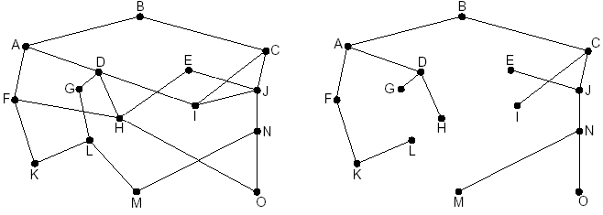
the optimality principle: the optimal route
if router J is on the optimal path from I to K, then the optimal path from J to K also falls along the same route
why? if a route better than R2 existed from J to K, then the route from I to K could be improved by concatenating it with R1
the consequence of the optimality principle is that “the set of optimal routes from all sources to a given destination form a tree rooted at the destination”
such a tree is called a sink tree
a subnet sink tree for router B (distance metric is the number of hops)

Slide 17
the sink tree is not necessarily unique; as a tree it does not contain any loops;  each packet will be delivered within a finite and bounded number of hops; at least in theory
the goal of a routing algorithm is to discover the sink trees for all routers
the optimality principle and the sink tree serve as benchmarks to measure routing algorithms
Shortest Path Routing (static) for unicast routing (by Dijkstra)
aim: build a graph of the subnet - each node of the graph representing a router and each arc representing a link; the arcs are labeled as a function of any one of the metrics (distance, hop count, ...)
to select a route between two routers, the algorithm finds the “shortest” path between them on the graph

Slide 18
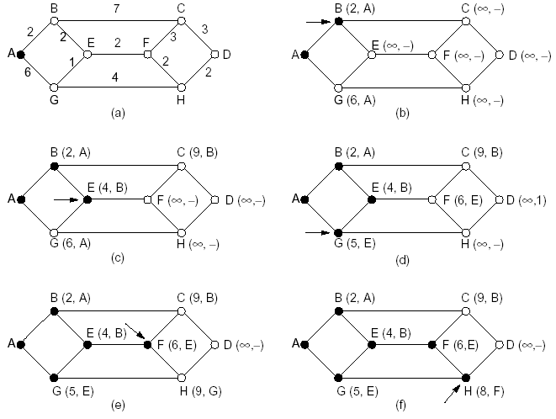
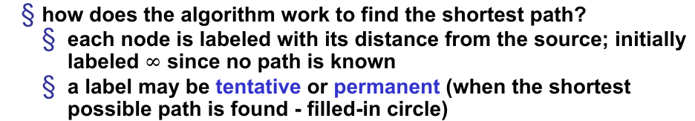
how does the algorithm work to find the shortest path?
each node is labeled with its distance from the source; initially labeled $∞$ since no path is known
a label may be tentative or permanent (when the shortest possible path is found - filled-in circle)
we want to find the path from A to D
the shortest path is ABEFHD

Slide 19
Flooding (static) for multicast and broadcast routing
every incoming packet is sent out on every outgoing line except the one it arrived on
packets received a second time are discarded
it generates too many duplicate packets
some measures required to avoid having an infinite number of packets; e.g. have a hop counter included in the header of each packet; initially initialized by the number of hops from source to destination; each hop decrements it and the packet is discarded when the counter is zero
selective flooding is a variant; send only on those lines that are going approximately in the right direction

Slide 20
possible applications include
to update all databases concurrently in a distributed database system (multicast routing)
in wireless networks where every station can listen (broadcast routing)
if there is a possibility of many routers being destroyed such as in a military application (may be for unicast transmission too)
flooding is not mostly practical
however, since flooding always chooses the shortest path, it can serve as a benchmark for other routing algorithms

Slide 21
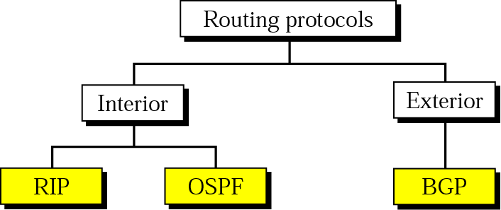
Unicast Routing Protocols
Interior
i. RIP - Routing Information Protocol
uses distance vector routing algorithm (dynamic)
also called distributed Bellman-Ford routing algorithm or Ford-Fulkerson algorithm
each router maintains a table (one entry per router) giving the best known distance to each destination
Destination | Hop Count | Next Router | Other information
163.5.0.0 | 7 | 172.6.23.4
197.5.13.0 | 5 | 176.3.6.17
189.45.0.0 | 4 | 200.5.1.6
115.0.0.0 | 6 | 131.4.7.19

Slide 22
the tables are updated by exchanging information with neighbors
in the general case, the metrics could be: number of hops, time delay in milliseconds, total number of packets queued along the path, ...
it is the original ARPANET routing algorithm (using queue length as a metric) and was used until 1979
the distance metric used in RIP is the number of hops
all networks are treated as equals, i.e., the cost of passing through each network is the same, it is one hop count

Slide 23
ii. OSPF - Open Shortest Path First
became a standard in 1990 by the IETF (Internet Engineering Task Force)
aim: to simplify the implementation at the boundaries between Autonomous Systems by having a standard for the interior routing
Network | Cost | Next Router | Other Information
N1 | 5 | C
N2 | 7 | D
N3 | 10 | B
N4 | 11 | D
N5 | 15 | C
IETF identified some requirements
has to be published in the open literature - proprietary solutions are not good
has to support a variety of
distance metrics (physical distance, delay, ...)
it has to be dynamic
has to do load balancing for better performance (the best route is not always the best)

Slide 24
has to support routing based on type of service
support for hierarchical systems - routers are not expected to know the entire topology - see later
introduce security so that spoofing routers by sending false routing information is avoided
uses link state routing algorithm (dynamic)
replaced distance vector routing in ARPANET
since distance vector routing does not consider bandwidth (no need initially since all lines were 56 Kbps; later some lines were upgraded) and other metrics
it uses Dijkstra’s algorithm to find the shortest path and construct the routing table

Slide 25
Exterior
BGP - Border Gateway Protocol
first appeared in 1989
it uses path vector routing algorithm (dynamic)
problems with the other algorithms
the route with the smallest hop count may not be the preferred route (if an autonomous system in which a packet passes is not secure, even though it is the shortest and for other political reasons)
they only announce the hop counts without actually defining the path that leads to the destination
in path vector routing, each entry in the routing table contains the destination network, the next router, and the path to reach the destination
Network | Next Router | Path
N01 | R01 | AS14, AS23, AS67
N02 | R05 | AS22, AS67, AS05, AS89
N03 | R06 | AS67, AS89, AS09, AS34
N04 | R12 | AS62, AS02, AS09

Slide 26
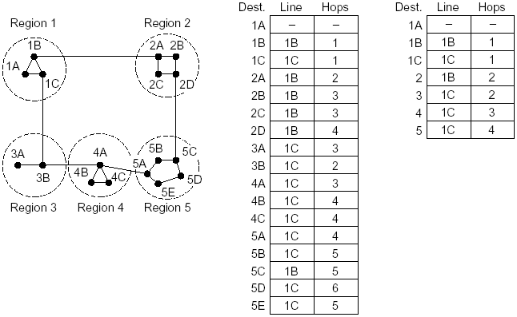
Hierarchical Routing
to limit the size of the routing table and the time for table look-up
the routers are divided into regions
each router knows all the details in its region; but knows nothing about the internal structure of the other regions

Slide 27
disadv: a packet may not follow the shortest path (e.g. to 5C)
for bigger networks, more hierarchies may be essential; region, zone, woreda, ...
how many levels? it has been shown that the optimal number of levels for an N router subnet is lnN, requires a total of e lnN entries per router

Slide 28
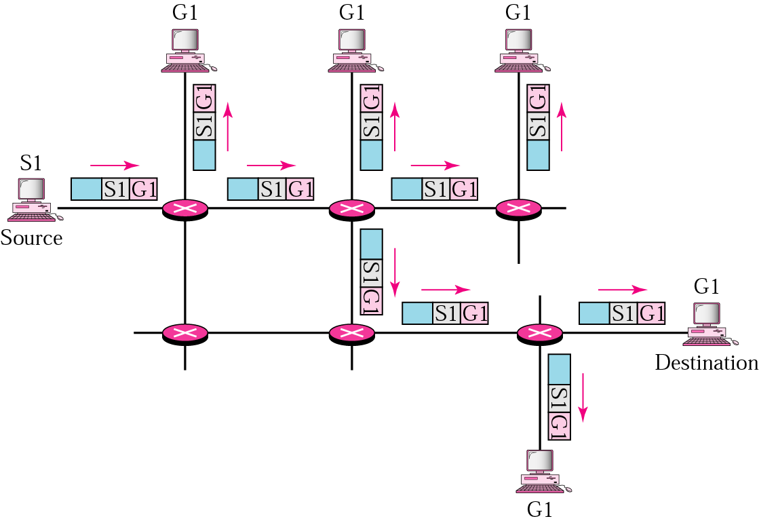
Multicast Routing
multicasting: delivery of data from one host to many destinations; as a result of multimedia applications
a one-to-many relationship
a multicast router may forward a received packet through several of its ports (or discard it if it is not in the multicast path)

Slide 29
it requires group membership management - to create and destroy groups, to allow processes (loyal members) to join and leave groups
one such protocol is IGMP (Internet Group Management Protocol)
has various versions - we don’t deal with the details
not a concern of the routing algorithm; routers should only know which of their hosts belong to which groups
a multicast router connected to a network has a list of multicast addresses of the groups for which the router distributes packets to groups with at least one loyal member in that network
for each group, there is one router which has the duty of distributing the multicast packets destined for that group

Slide 30
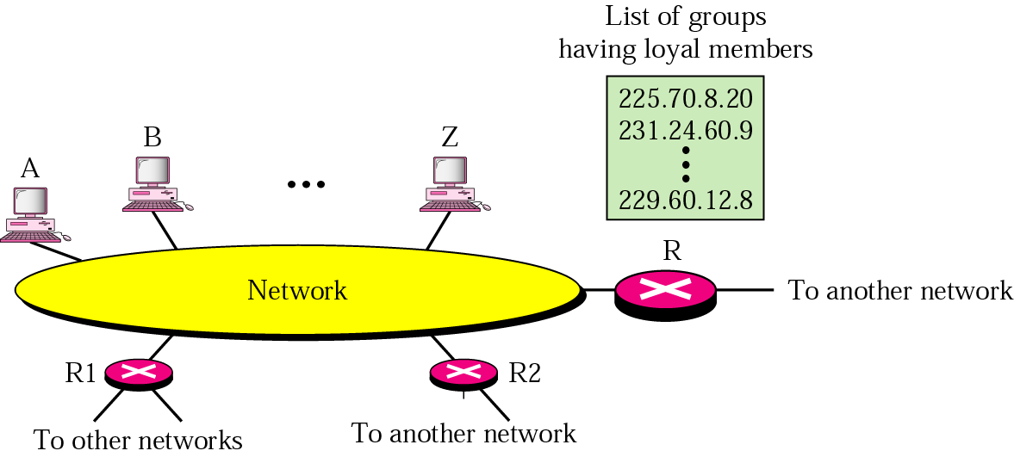

Slide 31
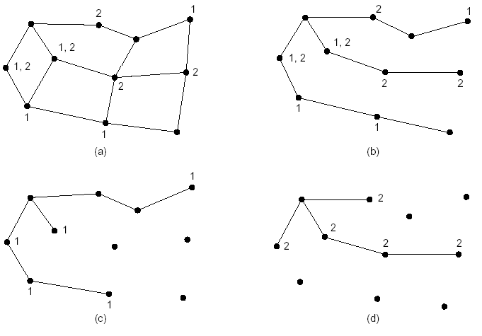
for multicasting, each router computes a spanning tree covering all other routes
entire network with two groups where a node may belong to a single group, two groups, or none (see the numbers on the nodes)
a spanning tree for the left most router
pruned spanning tree for Group 1
pruned spanning tree for Group 2

Slide 32
several ways of pruning the tree exist
the simple one is if link state routing is used - each router is aware of the complete topology, including which hosts belong to which groups
Multicast Routing Protocols
there are several multicast routing protocols (implemented or proposed)
DVMRP - Distance Vector Multicast Routing Protocol
an extension of distance vector routing
MOSPF - Multicast Open Shortest Path First
an extension of the OSPF protocol
CBT - Core-Based Tree
it uses a core (center router or rendezvous router) as the root of the tree
an autonomous system is divided into regions, and a core is chosen for each region

Slide 33
PIM - Protocol Independent Multicast
it has two varieties
PIM-DM - Protocol Independent Multicast-Dense Mode
used when there is a possibility that each router is involved in multicasting
PIM-SM - Protocol Independent Multicast-Sparse Mode
used when there is a slight possibility that each router is involved in multicasting
multicasting has many applications
access to distributed systems
information dissemination
distance learning
multimedia communications

Slide 34
Broadcast Routing Protocols
sending a packet to all destinations simultaneously
possible applications
distributing weather reports, stock market updates, live radio programmes
the Internet does not explicitly support broadcasting (creates a huge amount of traffic and needs a huge bandwidth)
methods
1. send the packet to each destination
wastes bandwidth
the source must have a complete list of all the destinations - very big table
2. flooding
generates too many packets and consumes too much bandwidth

Slide 35
3. multidestination routing
each packet contains either a list of destinations or a bit map - major problem
a router receiving a packet generates a new copy of the packet for each output line to be used and includes in each packet only those destinations that are to use the line
after some hops, each packet will carry only one destination and can be treated as a normal packet
4. using a spanning tree
used by the originating router and the subsequent ones
good use of bandwidth
but each router must have a knowledge of some spanning tree
5. reverse path forwarding
applicable even if routers do not have a knowledge of spanning trees
when a packet arrives, the router checks if it arrived on the line that is normally used for sending packets to the source (the shortest path)

Slide 36
4.4 Packetizing and Fragmenting
Packetizing: encapsulates packets received from upper-layer protocols and makes new packets out of them; done by the IP protocol in the Internet model
Fragmenting: a datagram can travel through different networks; each router decapsulates the IP datagram from the received frame, processes it, and then encapsulates it in another frame
the format and size of the
received frame depends on the protocol used by the physical network from which the frame has just arrived
departing frame depends on the protocol used by the physical network to which the frame is going

Slide 37
Other Issues (of Internet that are not directly related to the duties of the network layer)
Address Resolution: the network layer provides only host-to-host addressing whereas the data link layer needs physical addresses for node-to-node delivery; these addresses must be mapped; details later in the Address Resolution Protocol
Multicasting and Routing Protocols - covered earlier

Slide 38
The Network Layer in the Internet

Slide 39
there are 5 network layer protocols in the TCP/IP protocol suite (IP, ARP, RARP (DHCP), ICMP, and IGMP)
the main protocol is IP, the glue that holds the whole Internet together and responsible for host-to-host delivery
it needs the services of other protocols
ARP (Address Resolution Protocol) - maps an IP address to a MAC address (of the next hop)
RARP (Reverse ARP) - maps a MAC address to an IP address; usually used in some situations such as when a diskless host is booted; it gets the binary image of its operating system from a remote file server but does not know its IP address; obsolete, replaced by DHCP- Dynamic Host Configuration Protocol
ICMP (Internet Control Message Protocol) - to handle unusual situations such as the occurrence of an error
IGMP (Internet Group Management Protocol) - for multicasting since IP is designed for unicast delivery; you can read about it

Slide 40
4.4 IP v4 and Subnetting
unlike the older ones, it was designed with internetworking in mind
it is unreliable and connectionless datagram protocol - a best effort delivery service (no error control or flow control); it only detects errors and discards the packet if it is corrupted
if reliability is important, it must be paired with a reliable protocol such as TCP (at the transport layer); like the post office, get your important mails registered
an IP datagram consists of a header part and a text part
the header has a 20-byte fixed part and a variable length optional part
it is transmitted in big endian order: from left to right, with the high-order bit of the Version field going first (SPARC is big endian; Pentium is little endian); software conversion is required on little endian machines

Slide 41
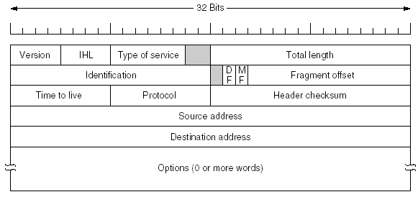
Version (4 bits): keeps track of which version of the protocol the datagram belongs (for future transitions between new and old versions); currently 4
IHL (4 bits): length of the header in 32-bit words (minimum value is 5, which applies when no options are present; maximum value is 15, which limits the header to 60 bytes, and thus the Options field to 40 bytes)
Type of service (8 bits): designed to distinguish between different classes of service - for various combinations of reliability (e.g. file transfer) and speed (e.g. voice); mostly ignored by current routers
The IPv4 header

Slide 42
Total length (16 bits): of everything in the datagram - both header and data (max. length is 2¹⁶ = 65,536 bytes)
Identification (16 bits): for the destination host to determine which datagram a newly arrived fragment belongs to (all the fragments of a datagram contain the same Identification value)
DF (1 bit): Don’t Fragment; the destination is incapable of putting the pieces back together; all machines are required to accept fragments of 576 bytes or less
MF (1 bit): More Fragments; all fragments except the last one have this bit set to know when all fragments of a datagram have arrived
Fragment offset (13 bits): tells where in the current datagram this fragment belongs; all fragments except the last one in a datagram must be a multiple of 8 bytes; a maximum of 8192 fragments per datagram allowed (2¹³) giving a maximum datagram length of 65,536 bytes (8*8192)

Slide 43
Time to live (8 bits): to prevent datagrams from wandering around forever; is a counter used to limit packet lifetimes; a maximum lifetime of 255 sec (in practice counts the number of hops); set by a source host approximately 2 times the maximum number of hops between any two hosts; decremented on each hop and is supposed to be decremented multiple times when queued for a long time in a router; when it is zero, the packet is discarded and a warning packet is sent back to the source host
Protocol (8 bits): which transport process to give it to (TCP, UDP, ...)
Header checksum (16 bits): verifies the header only; the sum of all fields is assumed to be zero upon arrival; it must be recomputed at each hop because at least one field always changes (Time to live)
Source address and Destination address: IP addresses for the source and the destination - see later

Slide 44
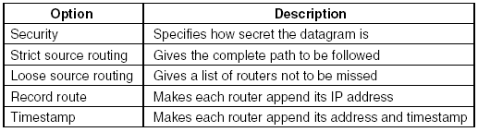
Options
to allow subsequent versions of the protocol to include information not present in the original design
to permit experimenters to try out new ideas, and
to avoid allocating header bits to information that is rarely needed
originally five options were defined
Security: for a router to specify not to route through certain countries; ignored by all routers in practice

Slide 45
Strict source routing: gives the complete path from source to destination as a sequence of IP addresses; useful for system managers to send emergency packets when the routing tables are corrupted, or for making timing measurements
Loose source routing: requires the packet to traverse the list of routers specified, and in the order specified; but may also pass through other routers on the way; most useful when political or economic considerations dictate passing through or avoiding certain countries
Record route: tells the routers along the path to append their IP address to the option field; for system managers to track down bugs in routing algorithms
Timestamp: each router also records a 32-bit timestamp; mostly for debugging routing algorithms

Slide 46
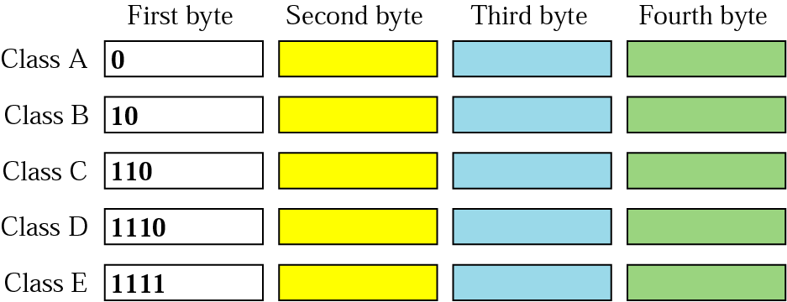
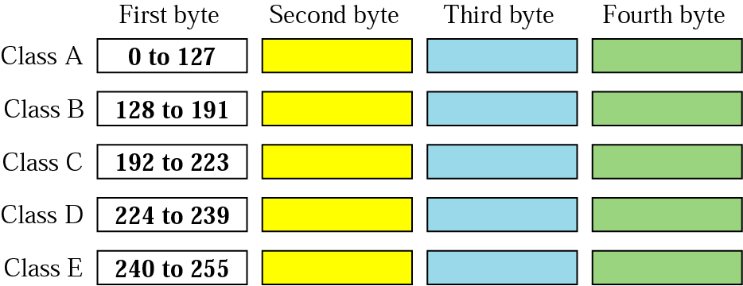
IP Addresses
every host and router on the Internet has an IP address (its network number and host number)
unique and universal for global communication (no 2 hosts have the same address, but a host can have 2 IP addresses)
32-bit in IPv4 written as 4 decimal numbers (128 in IPv6)
with 32-bits there are 2³² (4,294,267,296) hosts; assumed too many initially; now not sufficient due to a number of reasons (mainly wastage)
Classful Addressing
address space is divided into 5 classes: A, B, C, D, and E
the first few bits indicate the class of an address
in binary notation
in dotted-decimal notation

Slide 47
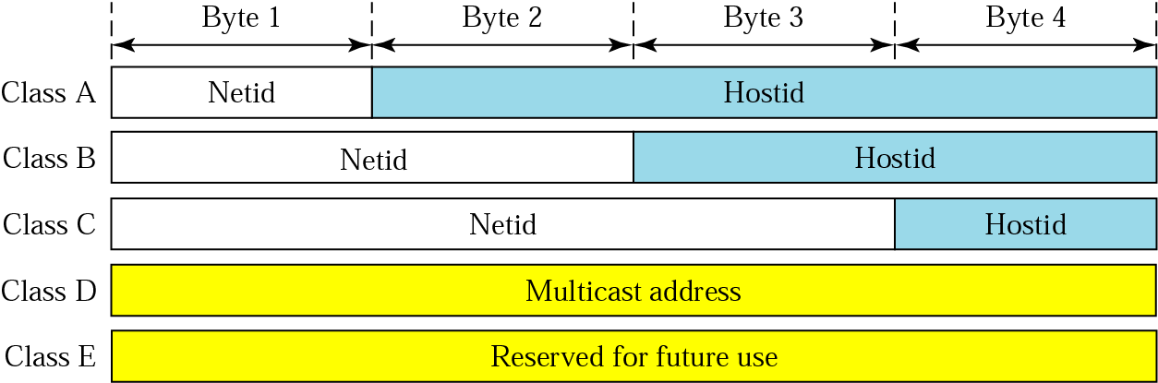
addresses in classes A, B, and C are for unicast communication; a host needs to have at least one unicast address to be able to send and receive
addresses in class D are for multicast communication (only as a destination); if a host belongs to a group or groups, it can have one or more multicast addresses
addresses in class E are reserved; the idea was to use them for special purposes
Netid and Hostid
addresses in classes A, B, and C are divided into netid (network) and hostid (host) of varying length from class to class

Slide 48
Classes and Blocks
one problem with classful addressing is that each class is divided into a fixed number of blocks with each block having a fixed size
Class A
divided into 128 blocks, each block having a different netid (the first bit of byte 1 is always 0)
block 1: from 0.0.0.0 to 0.255.255.255 - netid 0
block 2: from 1.0.0.0 to 1.255.255.255 - netid 1
.
.
last block: from 127.0.0.0 to 127.255.255.255 - netid 127
class A addresses were designed for large organizations (up to 16 million hosts 2²⁴)

Slide 49
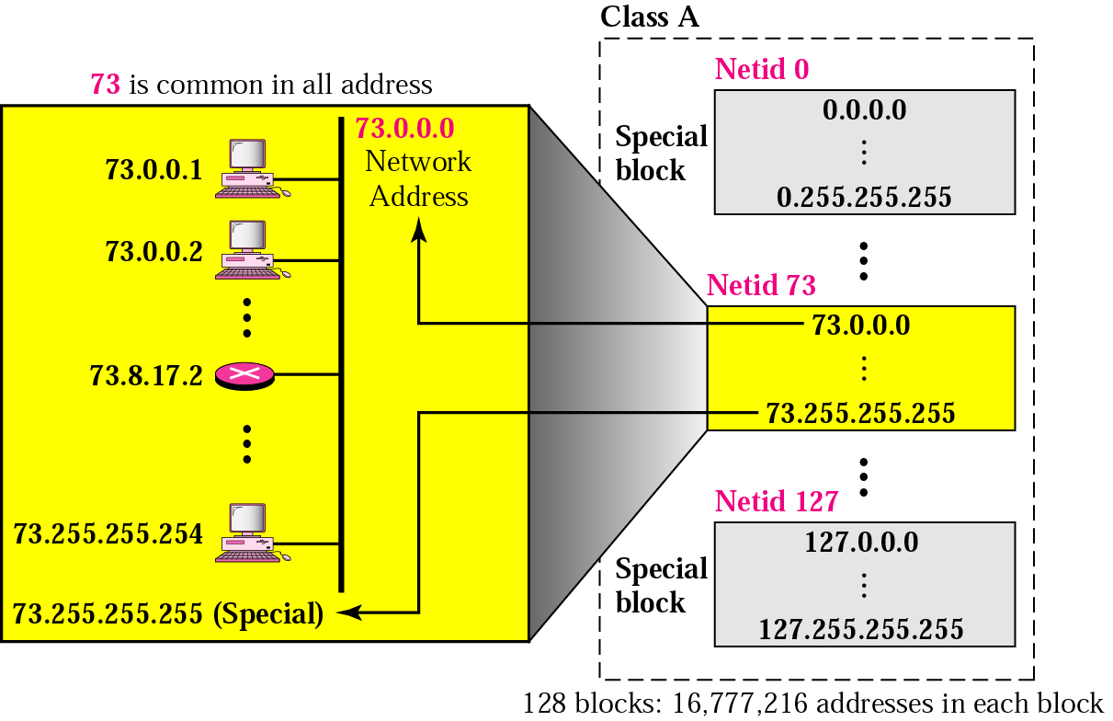
e.g. organization X granted a block with netid 73
the first address (73.0.0.0) is used to identify the organization (called the network address)
the last address is reserved for a special purpose
total number of organizations that can be assigned class A addresses is 126 (128-2) because all 0’s and 1’s are reserved
the number of addresses in each block (16,777,214= 2²⁴-2) are larger than the needs of almost all organizations
millions of class A addresses are wasted

Slide 50
Class B
divided into 16,384 (2¹⁴) blocks, each block having a different netid (the first two bits of byte 1 are always 10)
block 1: from 128.0.0.0 to 128.0.255.255 - netid 128.0
block 2: from 128.1.0.0 to 128.1.255.255 - netid 128.1
.
.
last block: from 191.255.0.0 to 191.255.255.255 - netid 191.255
16 blocks are reserved for private addresses
total number of organizations that can be assigned class B addresses is 16,368 (16,384-16)
class B addresses were designed for midsize organizations (up to 65,534 = 2¹⁶-2 hosts)
the number of addresses in each block is larger than the needs of most midsize organizations
many class B addresses are wasted

Slide 51
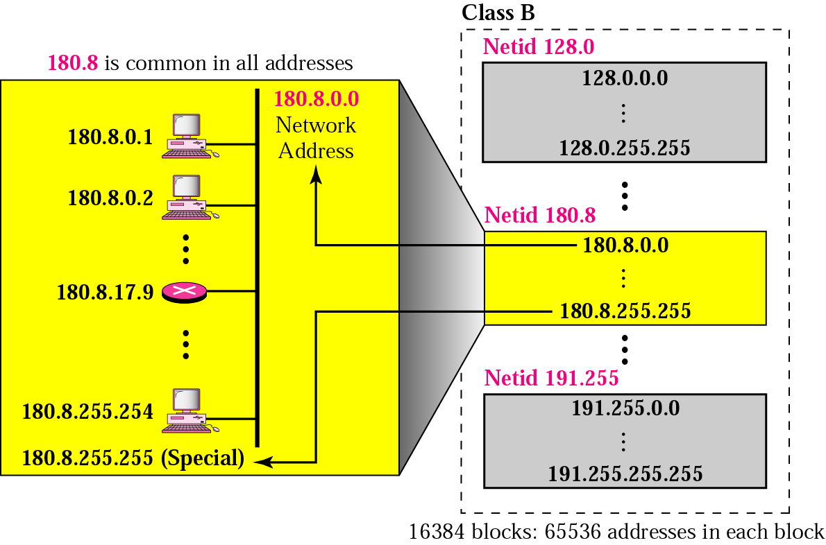

Slide 52
Class C
divided into 2,097,152 (2²¹) blocks, each block having a different netid (the first three bits of byte 1 are always 110)
block 1: from 192.0.0.0 to 192.0.0.255 - netid 192.0.0
block 2: from 192.0.1.0 to 192.0.1.255 - netid 192.0.1
.
.
last block: from 223.255.255.0 to 223.255.255.255 - netid 223.255.255
256 blocks are used for private addresses
total number of organizations that can be assigned class C addresses is 2,096,902 (2,097,152-256)
class C addresses were designed for small organizations (up to 254 = 2⁸-2 hosts)
the number of addresses in each block is so limited that most organizations do not want a block in this class

Slide 53
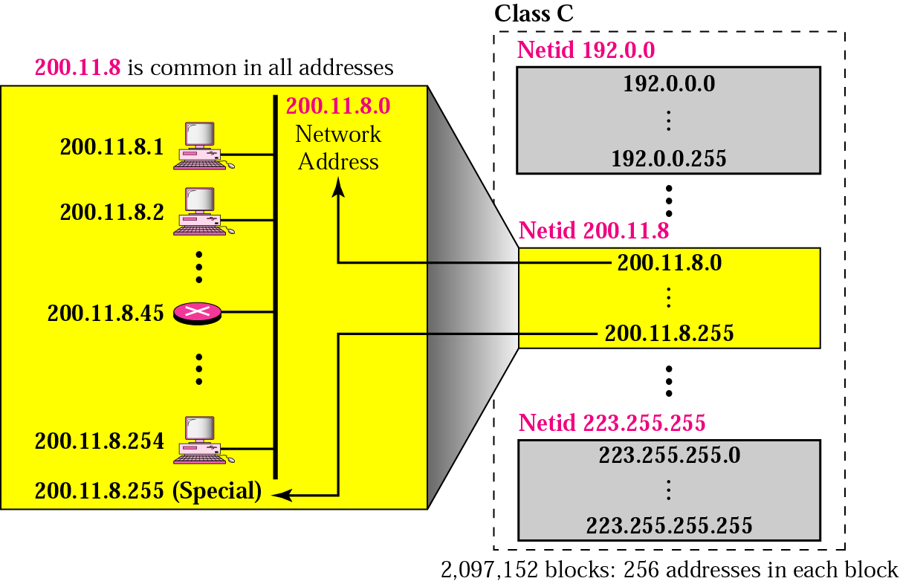

Slide 54
Class D: there is just one block of class D addresses; designed for multicasting
Class E: there is just one block of class E addresses; designed for use as reserved addresses; for research by IETF (Internet Engineering Task Force) at http://www.ietf.org; it develops Internet standards
Network Address
an address that defines the network itself
it cannot be assigned to a host
properties
all hostid bytes are 0s; it is different from a netid, a network address has both netid and hostid, with 0s for the hostid
it defines the network to the rest of the Internet; routing to a host is based on the network address
in classful addressing, the network address is the one that is assigned to the organization

Slide 55
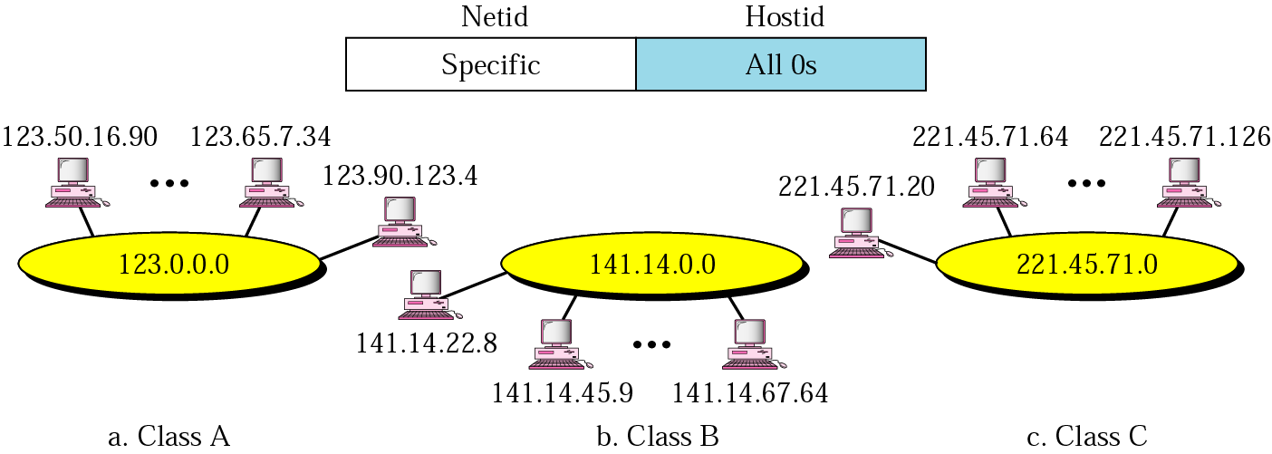
network addresses are managed by a nonprofit organization to avoid conflicts - ICANN (Internet Corporation for Assigned Names and Numbers); it has delegated parts of the address space to various regional authorities, which then allocate IP addresses to ISPs and other companies

Slide 56
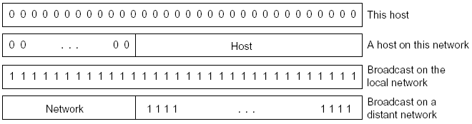
Special IP addresses
an IP address with all 0s (hostid and/or netid) means this network or this host
an IP address with all 1s (netid and/or hostid) means all the hosts on the indicated network for broadcasting

Slide 57
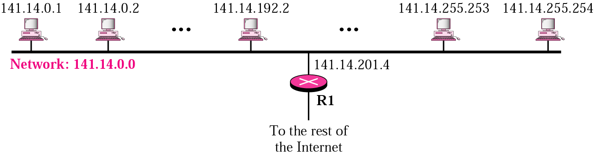
Subnetting
the netid is used by routers to route a packet destined for a network
IP addresses are designed with two levels of hierarchy (site and host)
a network with two levels of hierarchy
all the hosts in a network must have the same netid
problem: does not allow dividing of a network into logical groups (such as Departments in a University)

Slide 58
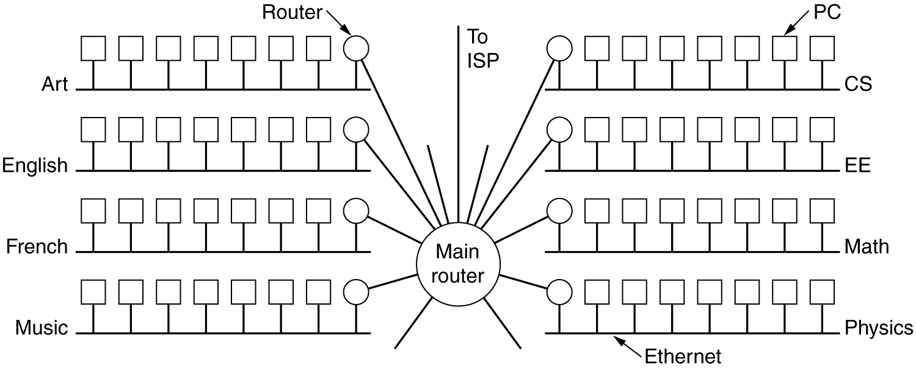
solution 1: get netids for all groups; impossible
solution 2: allow a network to be split into several parts for internal use but still act like a single network to the outside world (three levels of hierarchy: site, subnet, host)
a campus network consisting of LANs for various departments

Slide 59
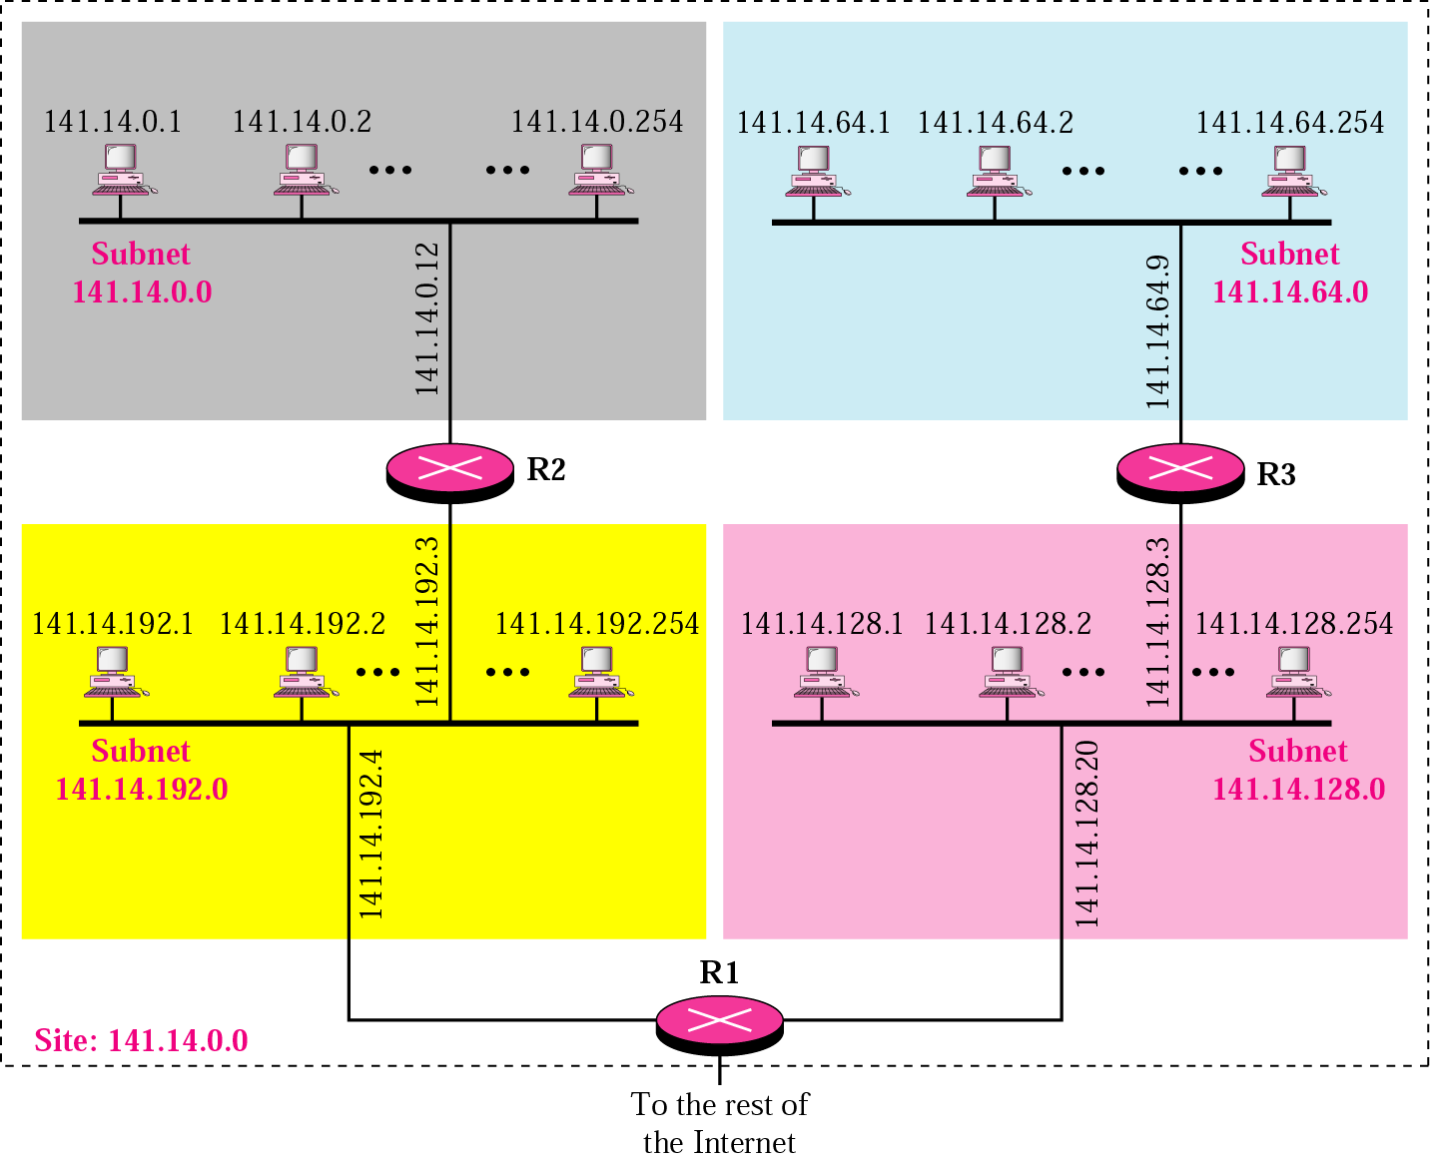
a network with three levels of hierarchy

Slide 60
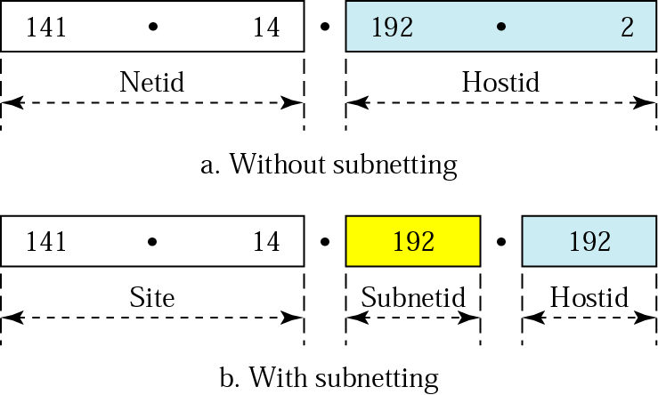
the parts of the network are called subnetworks or subnets (different from our previous definition of a subnet as the set of all routers and communication lines in a network)
routing of a datagram now involves three steps: delivery to the site, delivery to the subnetwork, and delivery to to the host
addresses in a network with and without subnetting

Slide 61
the IP hostid is divided into subnetid and hostid
e.g., for class B addresses subnetid could be 6 bits (2⁶=64 groups or subnets) and hostid could be 10 bits (2¹⁰-2 = 1022 hosts in each subnet)
this could be changed later if required (say if there are more subnets) by the organization itself without any authorization, say by ICANN
note: the first and last host numbers in a subnet are reserved; the first to identify the subnet itself; the last to broadcast within the subnet

Slide 62
Masking
how can a router find the network address or subnet address?
a 32-bit number called the mask is used; routers outside the organization use a default mask; routers inside the organization use a subnet mask
default mask: a 32-bit binary number that gives the network address when ANDed with an address in the block; the number of 1s is the same as the number of bits in the netid ( 8 for A, 16 for B, 24 for C); the rest are all 0
slash notation: an alternative mask notation, a slash followed by the number of 1s
Class | In Binary | In Dotted-Decimal | Using Slash
A | 11111111 00000000 00000000 00000000 | 255.0.0.0 | /8
B | 11111111 11111111 00000000 00000000 | 255.255.0.0 | /16
C | 11111111 111111111 11111111 00000000 | 255.255.255.0 | /24

Slide 63
e.g. a router outside the organization receives a packet with destination address 190.240.7.91; how does it find the network address to route the packet?
the router follows three steps:
it looks the first byte of the address to find the class; it is class B
the default mask for class B is 255.255.0.0; it ANDs this mask with the address to get 190.240.0.0
it looks in its routing table to find out how to route the packet to this destination

Slide 64
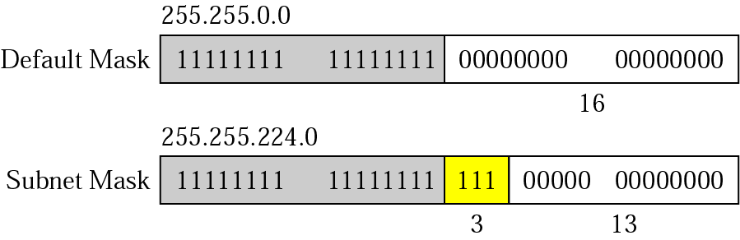
subnet mask: change some of the leftmost 0s in the default mask to 1s to make a subnet mask
the number of subnets is determined by the number of 1s (2^{n})
conversely, if the number of subnets is n, the number of extra 1s is log₂n

Slide 65
e.g. a router inside the organization receives a packet with destination address 190.240.33.91; how does it find the subnetwork address to route the packet?
the router follows three steps:
the router must know the mask; assume it is /19 as in the above figure
it applies the mask to the address; the subnet address is 190.240.32.0
it looks in its routing table to find out how to route the packet to this destination

Slide 66
Classless Addressing
there is too much wastage of IP addresses in classful addressing creating shortage of IP addresses
classless addressing was announced in 1996
the idea of variable-length blocks that belong to no class was introduced to allocate the remaining IP addresses
blocks of 2 addresses, 4 addresses, 64 addresses, ... can be assigned to an organization based on size
the number of addresses in a block must be a power of 2
the whole address space (2³² addresses) is divided into blocks of different sizes
the beginning address must be evenly divisible by the number of addresses; if a site needs, say, 2000 addresses it is given a block of 2048 addresses on a 2048 address boundary
we can still use subnetting if there is a need
an organization is given the beginning address of the block and a mask (in slash notation)

Slide 67
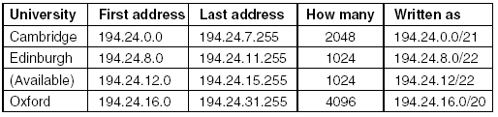
classeless addressing alleviates the depletion of addresses, but we now need a new method of forwarding packets, called CIDR (Classless InterDomain Routing)
there is now a single routing table for all networks consisting of an array of (IP address, subnet mask, outgoing line) triples
when a packet comes in, its destination IP address is first extracted; the routing table is then scanned entry by entry, masking the destination address and comparing it to the table entry looking for a match
it is possible that multiple entries (with different subnet mask lengths) match, in which case the longest mask is used; if there is a match for a /20 mask and a /24 mask, the /24 entry is used

Slide 68
consider the previous example; the table entries (in binary) for the three universities are
Base (First) Address Mask
C: 11000010 00011000 00000000 00000000 11111111 11111111 11111000 00000000
E: 11000010 00011000 00001000 00000000 11111111 11111111 11111100 00000000
O: 11000010 00011000 00010000 00000000 11111111 11111111 11110000 00000000
now consider what happens when a packet comes that is addressed to 194.24.17.4, which in binary is represented as
11000010 00011000 00010001 00000100
AND it with each mask and compare it with the base address
first it is ANDed with the Cambridge mask to get
11000010 00011000 00010000 00000000; does not match the Cambridge base address
then the original address is ANDed with the Edinburgh mask to get
11000010 00011000 00010000 00000000; does not match the Edinburgh base address

Slide 69
Oxford is tried next, yielding
11000010 00011000 00010000 00000000; it matches the Oxford base
if no longer matches are found farther down the table, the Oxford entry is used and the packet is sent along the line named in it
Read about NAT - Network Address Translation

Slide 70
IPv5
is (was) there IPv5?
yes, it was an experimental real-time stream protocol that was never widely used
was designed to coexist with IPv4, not a replacement

Slide 71
4.5 IPv6
the major goals are
Larger address space: to support billions of hosts, even with inefficient address space allocation (2¹²⁸ of them - if the entire earth, land and water, were covered with computers, IPv6 would allow 7 x 10²³ IP addresses per square meter - Tannenbaum)
Better header format: to simplify and speed-up the routing process
Better security: better encryption and authentication options
Support for resource allocation: to deal with the special requirements of real-time data (audio and video)
Allowance for extension: to allow the extension of the protocol if required by new technologies or applications in the future
Coexistence: permit the old and new protocols to coexist for years

Slide 72
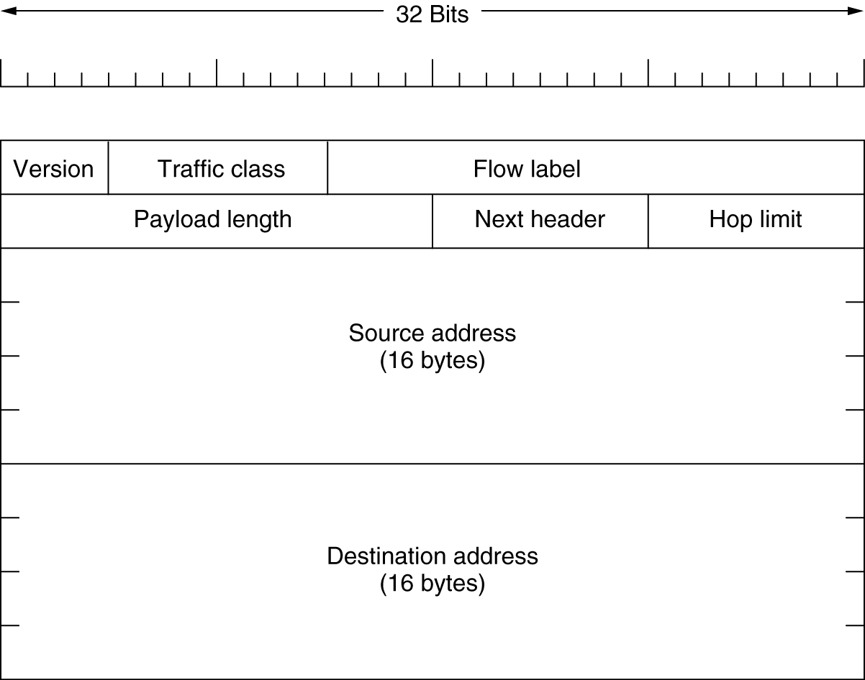

IPv6 header has 8 fields (40 bytes long)
Version (4 bits): is always 6 for IPv6 (and 4 for IPv4)
Traffic class (4 bits): used to distinguish between packets with different real-time delivery requirements
Flow label (24 bits): to provide special handling for a particular flow of data; for example, to reserve bandwidth because of some delay requirements
The IPv4 header
The IPv6 header

Slide 73
Payload length (16 bits): the total length of the IP datagram excluding the 40-byte base header
Next header (8 bits): defines the header that follows the base header; either one of the optional extension headers (currently six) or the header for an upper-layer protocol such as UDP or TCP
Hop limit (8 bits): same as the Time to live field in IPv4; a counter used to limit packet lifetimes
Source address and Destination address: IP addresses for the source and the destination; 16 bytes each

Slide 74
IPv6 addresses notation
hexadecimal colon notation: written as eight groups (each 2 bytes) of four hexadecimal digits with colons between the groups
8000:0000:0000:0000:0123:4567:89AB:CDEF
many addresses usually will have many zeros
three abbreviation methods
leading zeros (not the trailing ones) within a group can be omitted; 0123 can be written as 123
one or more groups of 16 zero bits can be replaced by a pair of colons; the above address now becomes
8000::123:4567:89AB:CDEF
it is allowed only once per address (if there are two runs of zero sections, only one of them can be abbreviated)
IPv4 addresses can be written as a pair of colons and an old dotted decimal number, for example
::192.31.20.46

Slide 75
Categories of Addresses
IPv6 defines 3 types
Unicast, Multicast
Anycast: defines a group of computers with addresses that have the same prefix; such a packet must be delivered to exactly one of the members of the group - the closest or the most easily accessible
transition from IPv4 to IPv6
it can not happen suddenly; smooth transition is required
three strategies designed: dual stack, tunneling, and header translation

Slide 76
4.6 Address Resolution
the data link layer hardware does not understand IP addresses
e.g., every Ethernet board comes with a 48-bit Ethernet address (issued by a central authority to avoid conflicts); such boards send and receive frames based on 48-bit Ethernet addresses; they know nothing about 32-bit IP addresses
a MAC address is a local address
delivery of a packet to a host or a router requires two levels of addressing: IP and MAC
a mapping of IP addresses to MAC addresses is required
two types of mapping: static and dynamic

Slide 77
Static Mapping
create a table that associates an IP address with a MAC address, stored in each machine on a network
network performance is degraded to update the table periodically (a machine could change its network card; in some LANs such as LocalTalk of apple, the MAC address changes every time the computer is turned on; a mobile computer can move from one physical network to another)
Dynamic Mapping
each time a machine knows one of the two addresses, it can use a protocol to find the other one
two protocols: ARP (maps an IP address to a MAC address) and RARP (maps a MAC address to an IP address; obsolete, replaced by DHCP- Dynamic Host Configuration Protocol)

Slide 78
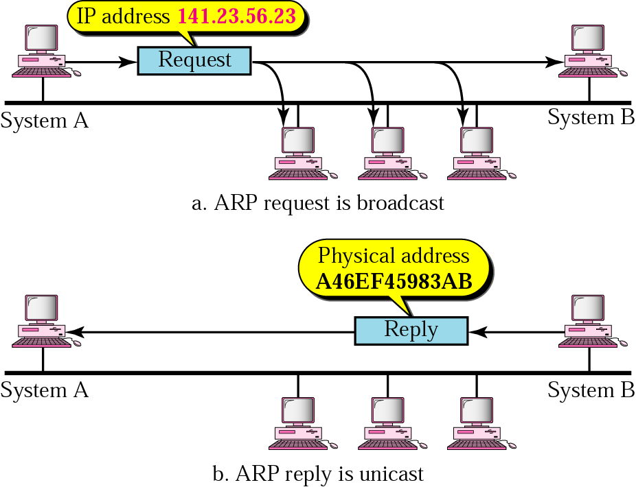
ARP (Address Resolution Protocol)
a host or a router looking for a MAC address broadcasts an ARP query packet - it includes the MAC (physical) and IP addresses of the sender and the IP address of the receiver
only the intended recipient sends back an ARP response packet (it contains the recipient’s IP and physical addresses); it is unicast

Slide 79
DHCP (Dynamic Host Configuration Protocol)
each computer connected to the Internet must have the following information
its IP address
its subnet mask
the IP address of a router
the IP address of a name server
such information can be saved in a configuration file of the client; but what if
it is diskless or
it is booting for the first time or
it has moved to another subnet
DHCP is a client-server program for assigning network addresses
IP addresses, default routers
it is an extension of BOOTP (that replaced RARP) that maps IP addresses to Ethernet addresses; but it requires manual configuration of the table by an administrator when a new host is added - static

Slide 80
DHCP allows both manual and automatic IP address assignment
a DHCP server has two databases
one that statically binds physical addresses to IP addresses
the second holds a list of unassigned IP addresses that makes DHCP dynamic
computers contact the DHCP server at boot-up time
the server checks its static database; if there is an entry that permanent address is returned
otherwise it dynamically assigns an IP address for a fixed period of time
i.e., addresses are “leased” for some time; when the time expires the client must request a renewal
this allows sharing of address space
results in more efficient use of address space

Slide 81
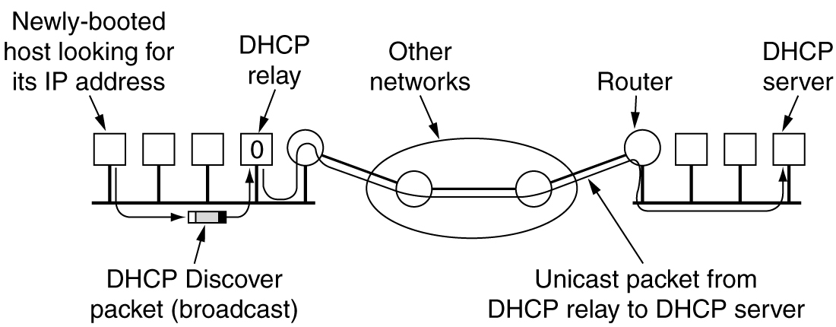
a DHCP relay agent is needed on each LAN since the DHCP server may not be reachable by broadcasting
Operation of DHCP

Slide 82
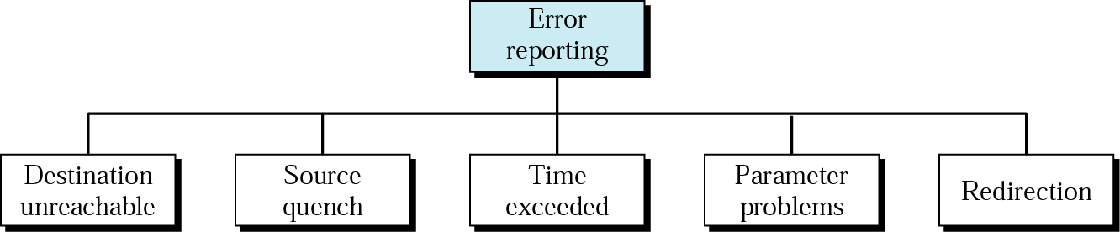
ICMP (Internet Control Message Protocol)
IP has no error reporting and error correcting mechanisms; if something goes wrong
it lacks a mechanism for host and management queries (is a router or a host alive?)
ICMP is a companion to the IP designed to compensate these two deficiencies
two type of ICMP messages: error-reporting and query messages
Error Reporting
always reports error messages to the original source (the only information included in the datagram is the source and destination addresses)

Slide 83
Destination unreachable: when a router cannot locate the destination or when a packet with the DF bit cannot be delivered because a ‘‘small-packet’’ network stands in the way; the datagram is discarded
Source quench: to slow down a source since IP is connectionless and lacks flow control and congestion control; rarely used because when congestion occurs, these packets tend to aggravate it; congestion control in the Internet is handled in the transport layer
Time exceeded: sent when a packet is dropped because its counter (Time to live) has reached zero (a symptom that packets are looping) or when all fragments that make up a message do not arrive at the destination host within a certain time limit
Parameter problem: indicates that an illegal value has been detected in a header field
Redirection: when a router notices that a packet seems to be routed wrong

